Slide 1
An Introduction to Natural Language Processing with Neural Networks
David Carlson
Duke University

Slide 2
What is happening today?
We are first going over the basics of “natural language processing”
Want to be able to automatically make sense of written language (whether “natural” or not!)
Later sessions will go through specific case studies
First, what can we do with natural language processing?

Slide 3


Sentiment Analysis
Machine Learning Model
“That movie was terrible!”
“This is the best jacket that I’ve ever owned”
“Not really that good.”

Slide 4
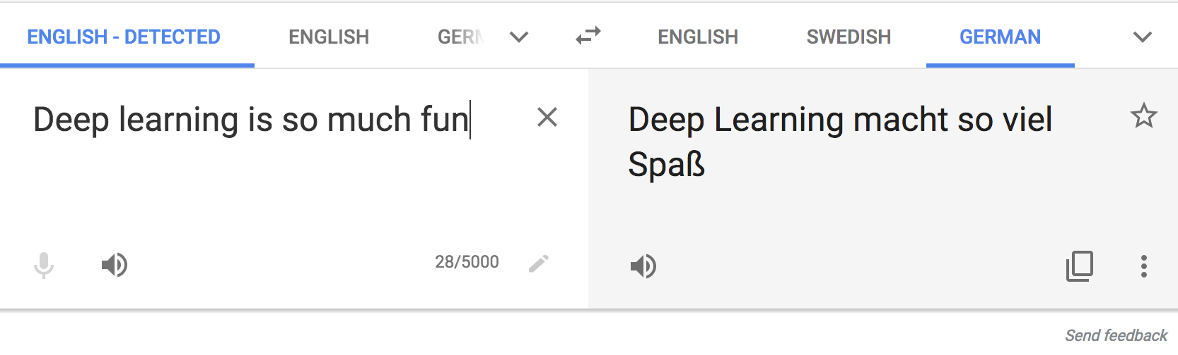
Text Translation
translate.google.com

Slide 5
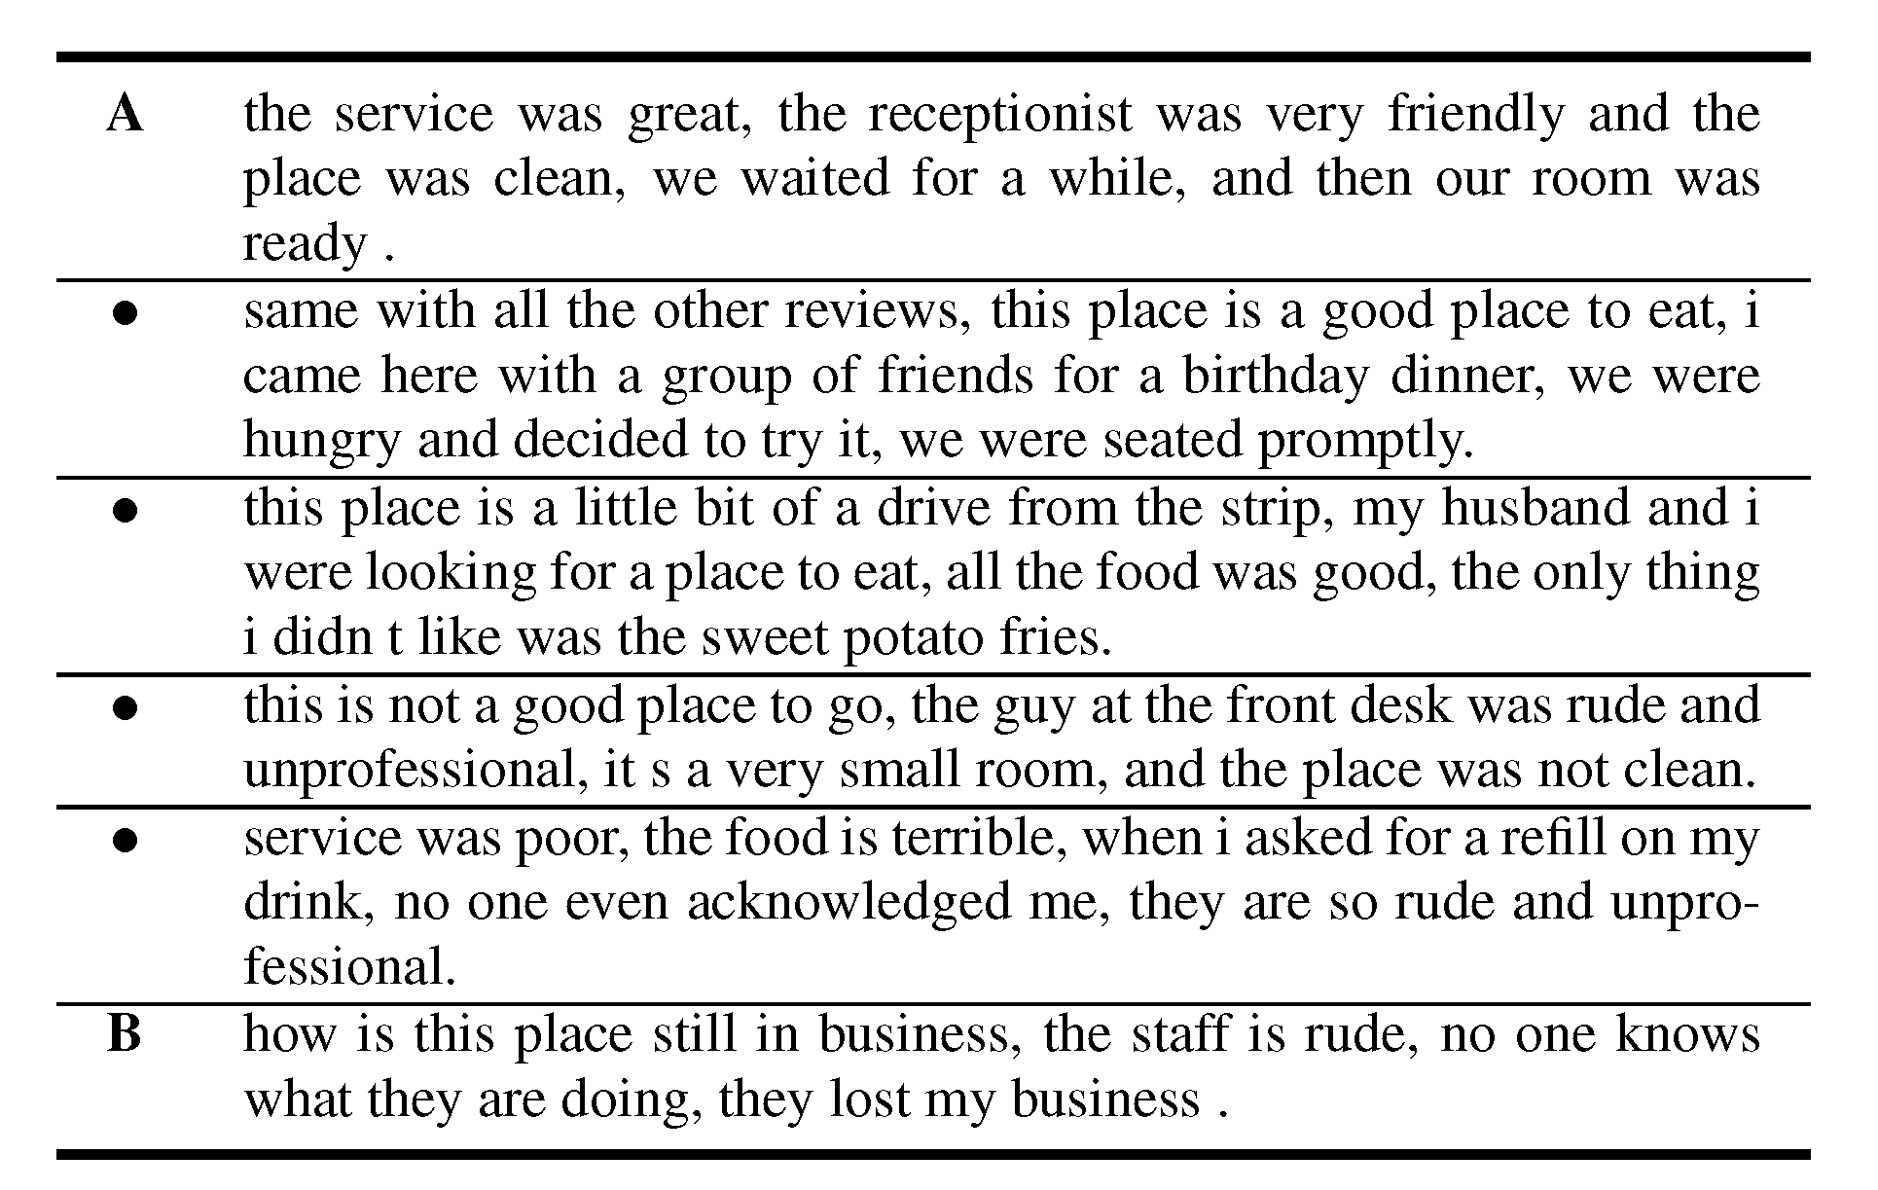
Automatic Text Synthesis

Slide 7
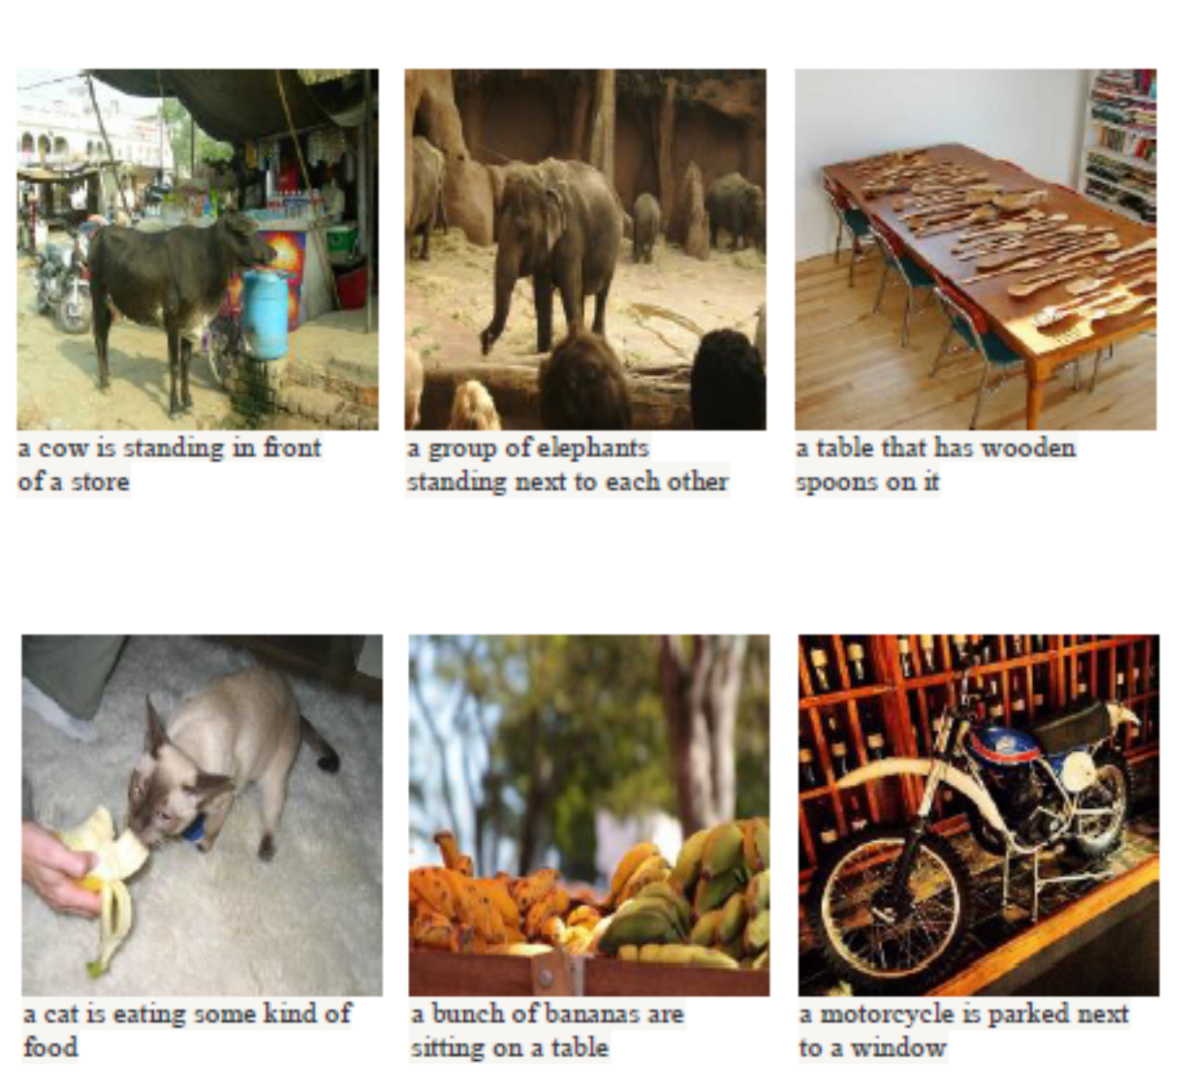
Automatic Image Captioning

Slide 8
How does this fit in our Previous Framework?

Slide 9
Sentiment Analysis
Machine Learning Model
“That movie was terrible!”
“This is the best jacket that I’ve ever owned”
“I’m pretty ambivalent about the whole thing. Not really that good.”
This is a binary classification, just like logistic regression!

Slide 10

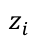
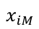
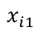
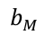
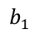
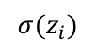
Revisiting Logistic Regression
Convert to Probability
$${σ(z}_{i})$$
$$z_{i}$$
Linear Model
$$b_{1}$$
$$b_{M}$$
$$x_{i1}$$
$$x_{iM}$$

Slide 11
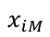
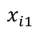
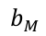
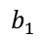
Revisiting our Linear Predictive Model
$$z_{i}$$
$$b_{1}$$
$$b_{M}$$
$$x_{i1}$$
$$x_{iM}$$
$$z_{i}=(b_{1}×x_{i1})+\left(b_{2}×x_{i2}\right)+⋯+\left(b_{M}×x_{iM}\right)$$
Big issue: we do not have a vector of features…

Slide 12
Language in a predictive model?

Slide 13
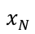
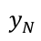
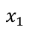
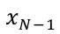
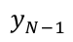
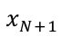
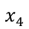
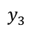
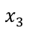
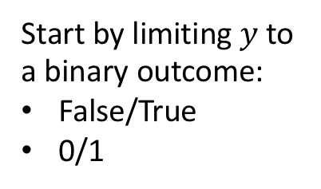
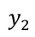
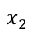
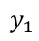
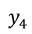
Our Previous Training Set Setup
$$x_{1}$$
$$y_{1}$$
$$x_{2}$$
$$y_{2}$$
$$x_{3}$$
$$y_{3}$$
Start by limiting $y$to a binary outcome:
False/True
0/1
$$x_{4}$$
$$y_{4}$$
$$x_{N−1}$$
$$y_{N−1}$$
$$x_{N}$$
$$y_{N}$$
New Data
$$x_{N+1}$$
?
Want to learn how to predict outcome

Slide 14
Our Previous Training Set Setup
$$x_{1}$$
$$y_{1}$$
$$x_{2}$$
$$y_{2}$$
$$x_{3}$$
$$y_{3}$$
Start by limiting $y$to a binary outcome:
False/True
0/1
$$x_{4}$$
$$y_{4}$$
$$x_{N−1}$$
$$y_{N−1}$$
$$x_{N}$$
$$y_{N}$$
New Data
$$x_{N+1}$$
?
Want to learn how to predict outcome

Slide 15
Our Training Set is Text
$$x_{1}$$
“That movie was terrible!”
$$y_{1}$$
$$x_{2}$$
“This is the best jacket…”
$$y_{2}$$
$$x_{3}$$
“Most awful thing ever…”
$$y_{3}$$
Start by limiting $y$to a binary outcome:
False/True
0/1
$$x_{4}$$
“One of the most amazing…”
$$y_{4}$$
$$x_{N−1}$$
“Will never buy again…”
$$y_{N−1}$$
$$x_{N}$$
“I’m rejuvenated…”
$$y_{N}$$
New Data
$$x_{N+1}$$
“This class is great!”
?
Want to learn how to predict outcome

Slide 16
Algorithms work on numbers
A simple question:
“Can we convert our text to a vector or sequence of numbers?”
If yes, we can start using our previous methodology!

Slide 17
First approach: Counting
Let’s define a dictionary of vocabulary words
Each word is assigned an index
Count the number of times that each word appears in each text example
“I am learning about deep learning”
Counting word occurrences
learning:2, I:1, am:1, about:1, deep:1

Slide 18
Counting the number of occurrences
The format is: index:count
Each section of text is now a vector, where the m^{th} entry is the number of times the m^{th} dictionary word occurred in that example.

Slide 19
Revisiting Logistic Regression
Convert to Probability
$${σ(z}_{i})$$
$$z_{i}$$
Linear Model
$$b_{1}$$
$$b_{M}$$
$$x_{i1}$$
$$x_{iM}$$
Word Counting
“This class is great!”

Slide 20
Comments
This word counting strategy can work decently well in practice
Can easily put in our deep models instead
But we’re not really processing “natural” language
Don’t capture word relationships (e.g. “not bad”=“good”)
Don’t capture word similarity (“cat” and “dog” are both pets, “lawyer” and “attorney” are synonyms)
Notes:
Don’t need to worry about punctuation
Stopper words: ‘the’
Don’t fix typos, the tend to give a good signal of who wrote the documen

Slide 21
Need to Understand Sequences
red
blue
green
black
white
I have a… …car.
lawyer
attorney
Let me talk to my…
.
All are different sequences with different words, but we want to utilize the similarity.

Slide 22
Big Question:
How can we represent the similarities between words?
Can imagine using a thesaurus to define similarities, but that will be limited
Need a (learnable) mathematical representation of word similarity

Slide 23
Word EMBeddings

Slide 24
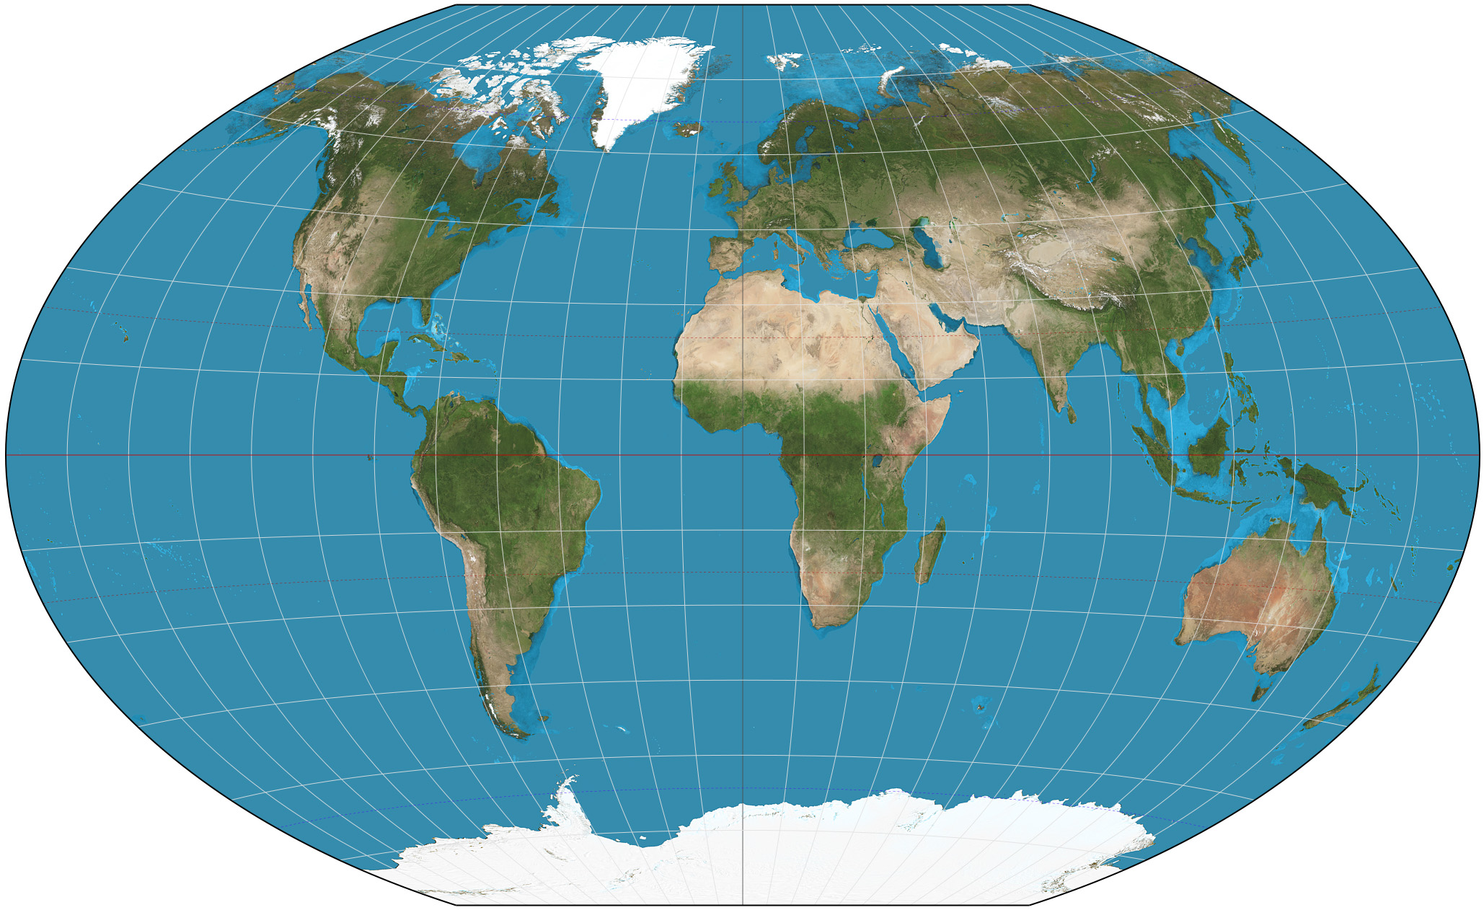
Similarities Based on Proximity
Points that are nearby spatially are likely to have similar attributes
May think of each location is a point in a 2D space (lat, long)
Measure similarity between places by their distance in 2D space

Slide 25
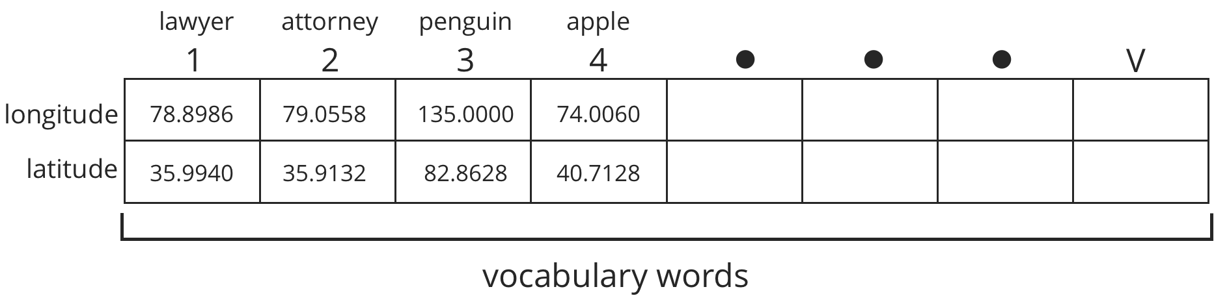
Map Each Word in Vocabulary to a Point in Space
Each word in a vocabulary is mapped to a point in a 2D space
The closer words are in the mapping, the more related/synonymous they are
The algorithm will learn the 2D point at which to place each word

Slide 26
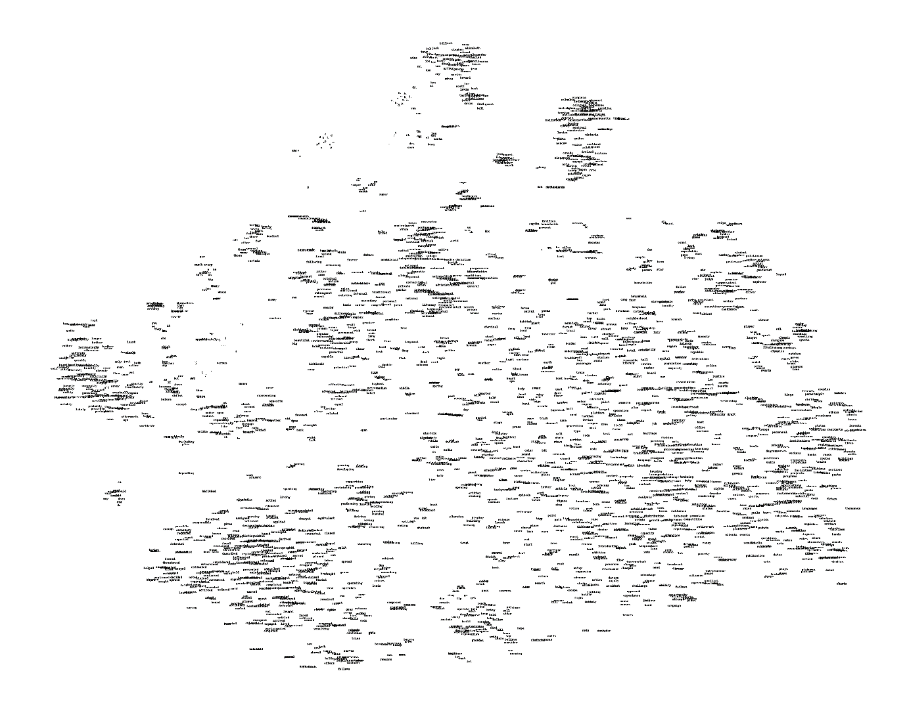
Example Word Geography
Here we show the learned geography of many different vocabulary words.
Too many words here to see! Let’s zoom in on a smaller section.

Slide 27
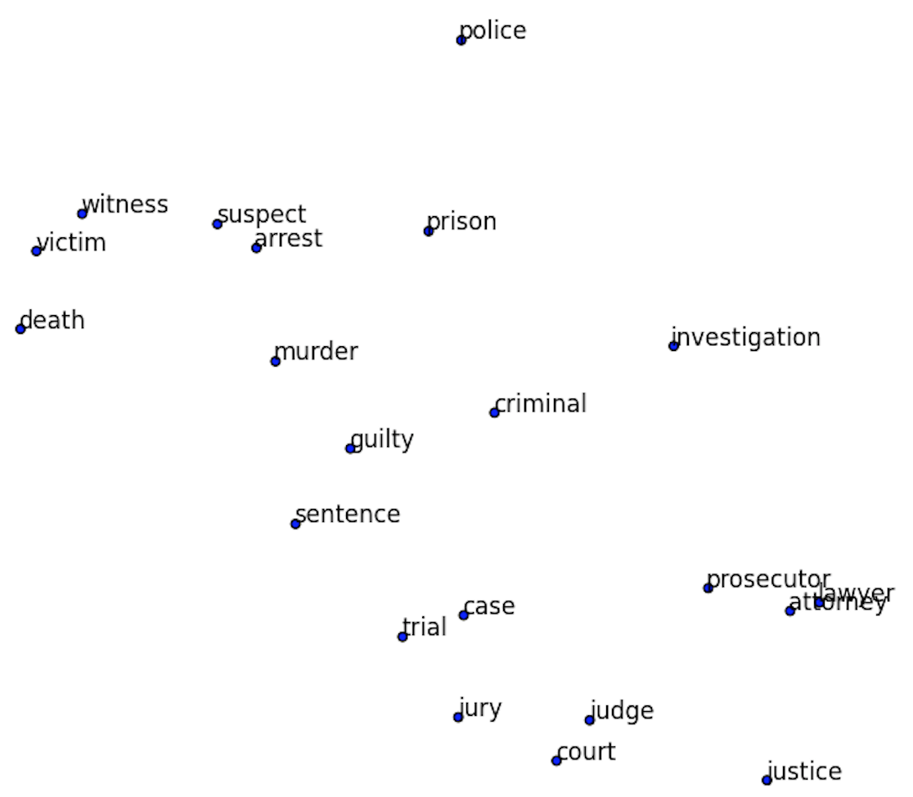
Example Word Geography
If we zoom in on a small region of our word map, it’s all related words.
Note the similarity of all the words as a whole, but also of the individual neighbors.
“Lawyer” and “attorney” are nearly identical in space!

Slide 28
Learn Geographical Relationships
The relationship between words can be maintained, we can do mathematical operations on these word vectors.
Add the same vector distance between man and woman will convert uncle to aunt and king to queen.
Plural relationships are also maintained.

Slide 29
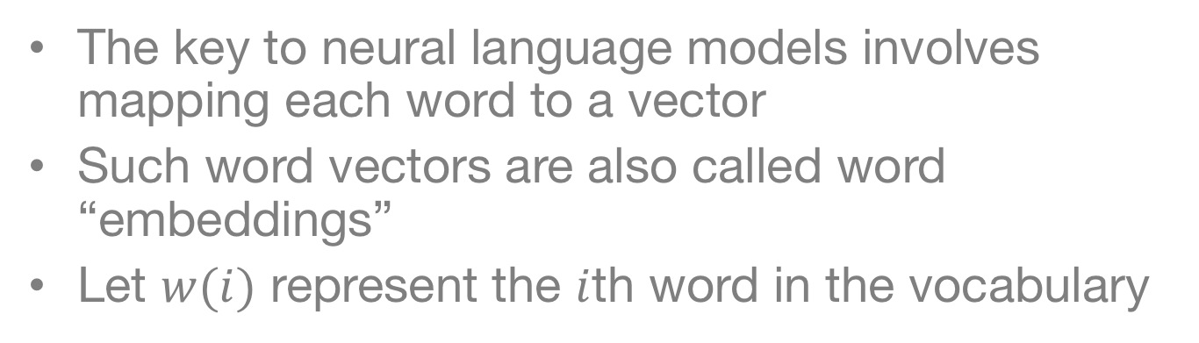
Word to Vector (Word2Vec)
The key to neural language models involves mapping each word to a vector
Such word vectors are also called word “embeddings”
Let $w(i)$ represent the $i$th word in the vocabulary

Slide 30
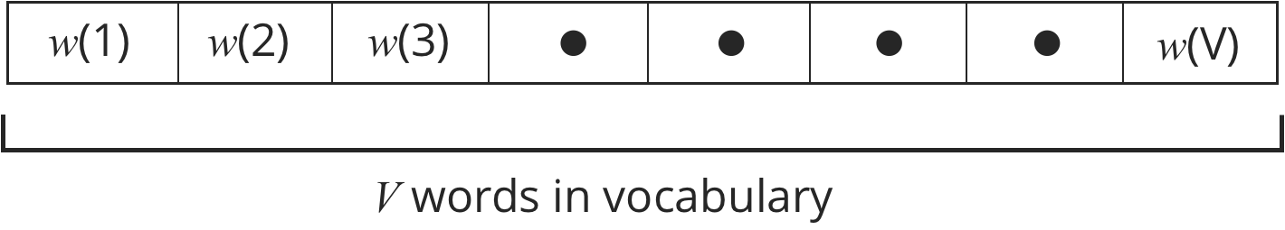
Word to Vector (Word2Vec)
Can think Word2Vec as a dictionary
Look up each word in the dictionary
If the word is in the dictionary, then we can look up the “definition” or location for it

Slide 31
Do we use 2-dimensional embeddings?

Slide 32
Do we use 2-dimensional embeddings?
2-dimensional locations are useful to illustrate similarity
Computationally, it turns out to be much easier to give each word a much longer address
Also representation is easier:
1 direction for plural
1 direction for past tense
1 direction for gender
etc…
The location vector will have M different entries
This is just like specifying a longer address (e.g. state, city, zip, street, house color, car color, etc…)

Slide 33
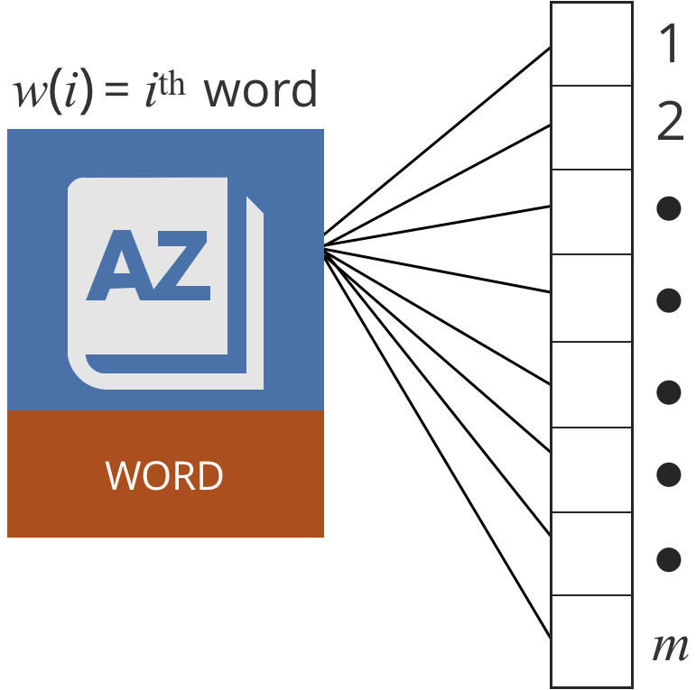
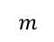
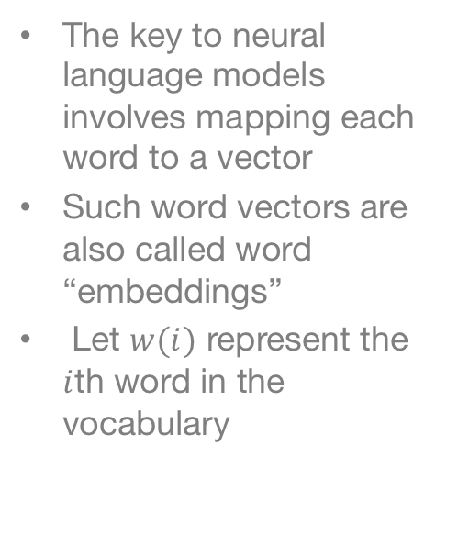
Word to Vector (Word2Vec)
The key to neural language models involves mapping each word to a vector
Such word vectors are also called word “embeddings”
Let $w(i)$ represent the $i$th word in the vocabulary
$$m$$
Notes:
How do you choose the w(i)
Word embeddings are determined by the model

Slide 34
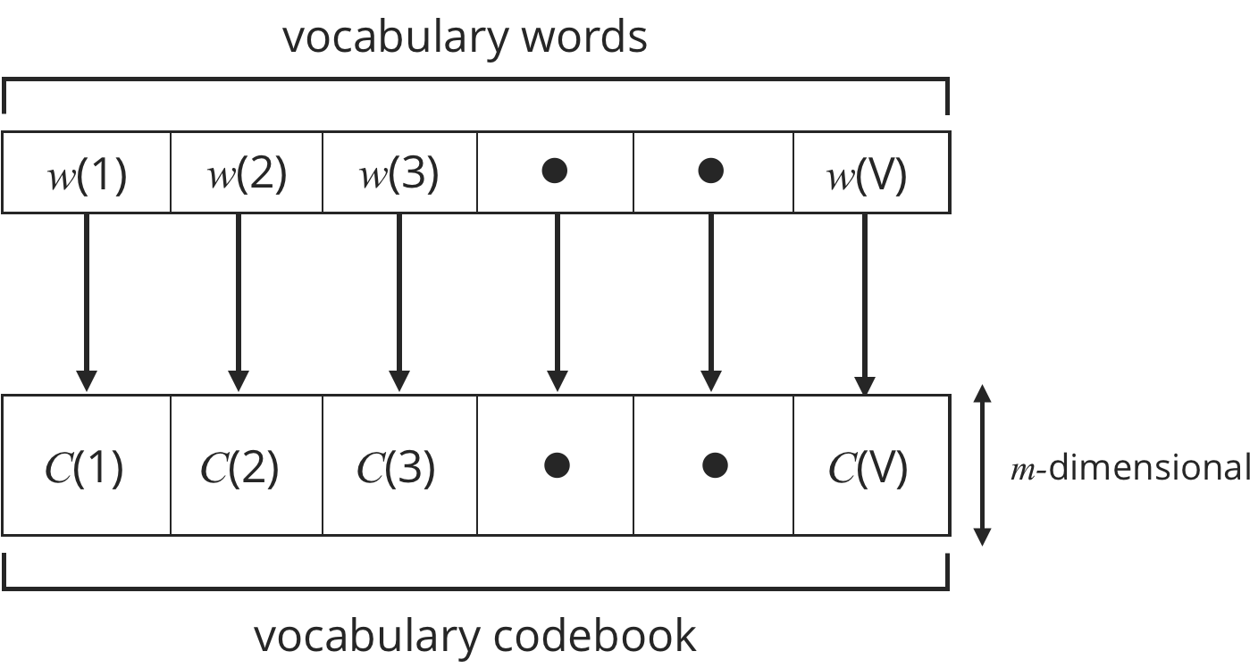
Word to Vector (Word2Vec)
The set of words in the vocabulary mapped to a codebook of vectors

Slide 35
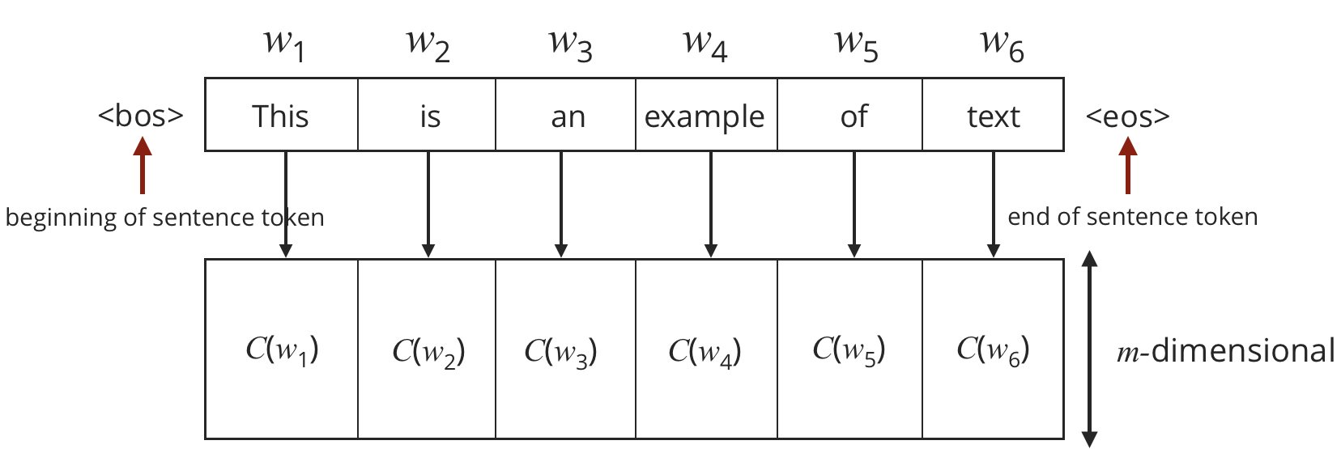
Looking up locations in a dictionary

Slide 36
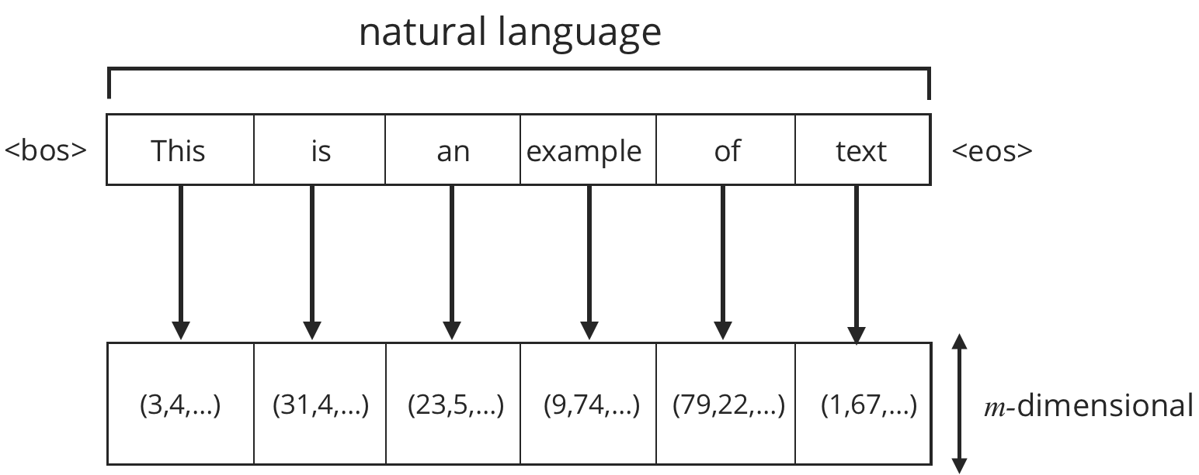
Converting a sentence to embeddings
We can construct a sequence of word embeddings to represent each sentence.
Each word is looked up in our dictionary individually
Specific tokens to mark “beginning of sentence” (<bos>) and “end of sentence” (<eos>)

Slide 37
How can we learn the dictionary?
We don’t start knowing this dictionary—must be learned from the data

Slide 38
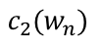
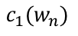
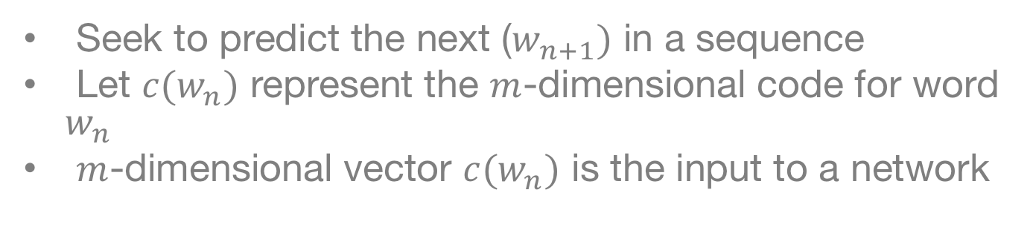
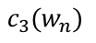
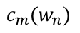
Unsupervised Learning of Word Vectors
Seek to predict the next ($w_{n+1})$ in a sequence
Let $c(w_{n})$ represent the $m$-dimensional code for word $w_{n}$
$m$-dimensional vector $c(w_{n})$ is the input to a network
$$c_{1}(w_{n})$$
$$c_{2}(w_{n})$$
$$c_{3}(w_{n})$$
$$c_{m}(w_{n})$$

Slide 39
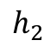
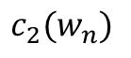
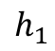
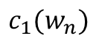
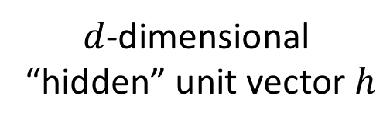
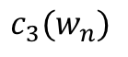



Model Construction
$$c_{1}(w_{n})$$
$$h_{1}$$
$$c_{2}(w_{n})$$
$$h_{2}$$
$$c_{3}(w_{n})$$
$$h_{3}$$
$d$-dimensional
“hidden” unit vector $h$
$$c_{m}(w_{n})$$
$$h_{d}$$

Slide 40












Model Construction
$$h_{j}=g\left[{ W}_{1j}⋅c_{1}+W_{2j}⋅ c_{2}+…+W_{mj}⋅c_{m}+b_{j}\right]$$
$$W$$
$$C_{1}$$
$$h_{1}$$
$$C_{2}$$
$$h_{2}$$
$g\left[x\right]$=tanh($x$)
$$C_{3}$$
$$h_{3}$$
$$C_{m}$$
$$h_{d}$$

Slide 41











Concise Description
$$W$$
$g\left[x\right]$=tanh($x$)
$$C_{1}$$
$$h_{1}$$
$$C_{2}$$
$$h_{2}$$
$$C_{3}$$
$$h_{3}$$
$$C_{m}$$
$$h_{d}$$
Vector
$$h=tanh\left[W⋅c+b\right]$$

Slide 42










Predicting Words
$$U$$
$$y_{1}$$
$$y_{2}$$
$$W$$
$$y_{3}$$
$$C_{1}$$
$$C_{2}$$
$$C_{3}$$
$$C_{m}$$
$$h$$
$$y_{V}$$

Slide 43

Predicting Words
$$U$$
$$y_{1}$$
$$y_{2}$$
$$W$$
$$y_{3}$$
$$C_{1}$$
$$C_{2}$$
$$C_{3}$$
Output Dimension
is $V$, our vocabulary size
$$C_{m}$$
$$h$$
$$y_{V}$$

Slide 44

Predicting Words
$$U$$
$$y_{1}$$
$$y_{2}$$
$$W$$
$$y_{3}$$
$$C_{1}$$
$$C_{2}$$
$$C_{3}$$
Output Dimension
is $V$, our vocabulary size
$$C_{m}$$
$$h$$
$$y_{V}$$
$$y_{v}={U_{1v}⋅h}_{1}+U_{2v}⋅h_{2}+⋯+{U_{dv}⋅h}_{d}+β_{v}$$
Concisely:
$$y=U⋅h+β$$

Slide 45












Predicting Words
$$U$$
$$y_{1}$$
$$y_{2}$$
$$W$$
$$y_{3}$$
$$C_{1}$$
$$C_{2}$$
$$C_{3}$$
$$C_{m}$$
$$h$$
$$y_{V}$$
Convert to probabilities:
$$p\left(w_{n+1}=i^{th} word | C\left(w_{n}\right)\right)=\frac{exp\left(y_{i}\right)}{exp\left(y_{1}\right)+exp\left(y_{2}\right)+…+exp\left(y_{V}\right)}$$

Slide 46




Predicting Words
$$U$$
$$y_{1}$$
$$p(w(1)|C)$$
$$y_{2}$$
$$p(w(2)|C)$$
$$W$$
$$y_{3}$$
$$p(w(3)|C)$$
$$C_{1}$$
$$C_{2}$$
$$C_{3}$$
Softmax
$$C_{m}$$
$$h$$
$$y_{V}$$
$$p(w(V)|C)$$
Convert to probabilities:
$$p\left(w_{n+1}=i^{th} word | C\left(w_{n}\right)\right)=\frac{exp\left(y_{i}\right)}{exp\left(y_{1}\right)+exp\left(y_{2}\right)+…+exp\left(y_{V}\right)}$$

Slide 47














Neural Text Model
$$y_{1}$$
$$p(w(1)|C)$$
$$U$$
$$y_{2}$$
$$p(w(2)|C)$$
$$W$$
$$p(w(3)|C)$$
$$y_{3}$$
$$C_{1}$$
$$C_{2}$$
$$C_{3}$$
Softmax
$$C_{m}$$
$$h$$
$$y_{V}$$
$$p(w(V)|C)$$

Slide 48
Neural Text Model
$$y_{1}$$
$$p(w(1)|C)$$
$$U$$
$$y_{2}$$
$$p(w(2)|C)$$
$$W$$
$$p(w(3)|C)$$
$$y_{3}$$
$$C_{1}$$
$$C_{2}$$
$$C_{3}$$
Softmax
$$C_{m}$$
$$h$$
$$y_{V}$$
Input: Word vector for
particular word in document
$$p(w(V)|C)$$

Slide 49
Neural Text Model
$$y_{1}$$
$$p(w(1)|C)$$
$$U$$
$$y_{2}$$
$$p(w(2)|C)$$
$$W$$
$$p(w(3)|C)$$
$$y_{3}$$
$$C_{1}$$
$$C_{2}$$
$$C_{3}$$
Softmax
$$C_{m}$$
$$h$$
$$y_{V}$$
$$p(w(V)|C)$$
Output: Probability of next word

Slide 50
Neural Text Model
$$y_{1}$$
$$p(w(1)|C)$$
$$U$$
$$y_{2}$$
$$p(w(2)|C)$$
$$W$$
$$p(w(3)|C)$$
$$y_{3}$$
$$C_{1}$$
$$C_{2}$$
$$C_{3}$$
Softmax
$$C_{m}$$
$$h$$
$$y_{V}$$
$$p(w(V)|C)$$
Will learn the word embedding to improved prediction of the next word.

Slide 51
Use More Than a Single Word?
The previous framework can be used to learn word embeddings effectively, but is limited by the small neighborhood.
Can we incorporate more of the language into learning the word embeddings?

Slide 52





Continuous Bag of Words (CBOW) Model
Word $n−2$
Word $n−1$
Average
Word
Vectors
Word $n$
Word $n+1$
Word $n+2$

Slide 53











Continuous Bag of Words (CBOW) Model
Word $n−2$
$$U$$
$$y_{1}$$
$$W$$
$$y_{2}$$
Word $n−1$
$$y_{3}$$
$$C_{1}$$
$$C_{2}$$
Average
Word
Vectors
$$C_{3}$$
Word $n$
Softmax
$$C_{m}$$
Word $n+1$
$$h$$
$$y_{V−1}$$
Word $n+2$

Slide 54

Continuous Bag of Words (CBOW) Model
Word $n−2$
$$U$$
$$y_{1}$$
$$W$$
$$y_{2}$$
Word $n−1$
$$y_{3}$$
$$C_{1}$$
$$C_{2}$$
Average
Word
Vectors
$$C_{3}$$
Softmax
Word $n$
Predict
Word $n$
$$C_{m}$$
Word $n+1$
$$h$$
$$y_{V−1}$$
Word $n+2$

Slide 55


Slide 56











$$U$$
$$y_{1}$$
There
$$W$$
$$y_{2}$$
$$C_{1}$$
$$y_{3}$$
Was
Average
Word
Vectors
$$C_{2}$$
Much
$$C_{3}$$
Softmax
Game
Hanging
Outside
$$C_{m}$$
The
$$h$$
$$y_{V−1}$$
Notes:
Use lags

Slide 57











Learning with CBOW
There is a true word and a prediction
Learn the model parameters C, W, U, b to predict the true word well
Uses same stochastic gradient descent techniques as before
$$U$$
$$y_{1}$$
There
$$W$$
$$y_{2}$$
$$C_{1}$$
$$y_{3}$$
Was
Average
Word
Vectors
$$C_{2}$$
Much
$$C_{3}$$
Softmax
Game
Hanging
Outside
$$C_{m}$$
The
$$h$$
$$y_{V−1}$$

Slide 58
Some Comments
This forms the basis of a word representation
Can learn the dictionary to minimize the associated loss on a large, unlabeled corpus
Can incorporate a larger history (more words)
How do we make this useful for predictions?

